Slide 1
DATA @ ANZ
DATA INSIGHTS

Slide 2
Data Quality Issues
Null Values
The following columns have null values/entries
Column Name Count of Null
card_present_flag 4326
bpay_biller_code 11158
merchant_id 4326
merchant_code 11160
merchant_suburb 4326
merchant_state 4326
merchant_long_lat 4326
Unique ID’s/Entries
Merchant ID – 5725(of 7718)
Customer ID – 100(of 12044)
Decimal Notation Consistency
Mismatched Decimal Notation in Columns : balance, amount

Slide 3
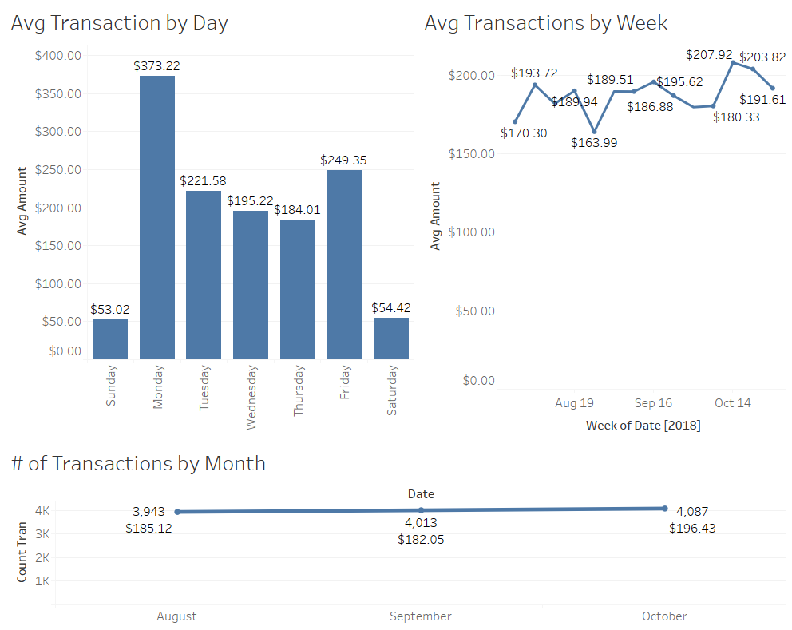
Data Insights
Monday has the highest value of Transactions followed by Friday
Based on week, there is a high degree of variability in Transactional value, this can possibly be correlated with marketing campaigns
Based on month, there has been a steady increase in number of transactions
Drop in avg value of transactions b/w Aug-Sep

Slide 4
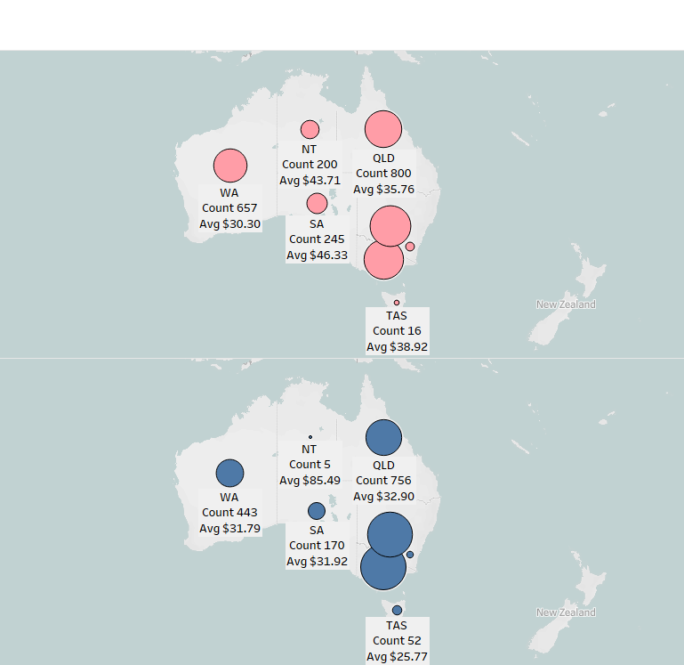
Data Insights
Location-based transactional data is consistent amongst both genders
VIC, NSW & QLD have the highest number of individual Transactions
NT is an exception based on gender - Higher count of female transactions with a lower avg transactional value as compared to male

Slide 5
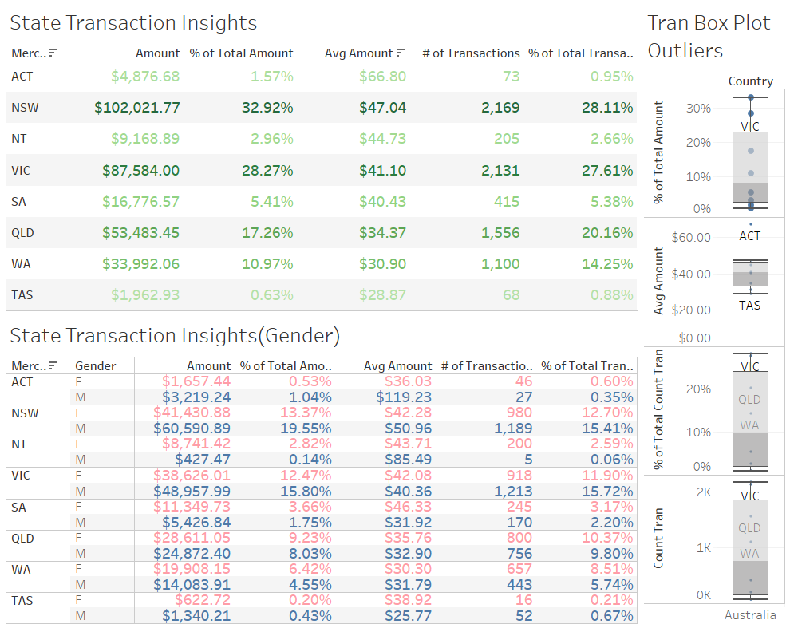
Data Insights
Outliers are present based on the average value and count of transactions
Although ACT has the of 1.57% of the total transaction sum, it has the highest avg transactional value at $66.80
Based on gender, data does show a larger percentage in both value and number of transactions for the Male demographics with few exceptions.
NSW, VIC, QLD values(although highest) need to be correlated with costs to determine actual profitability

